Slide 1
CS 4530 & CS 5500
Software Engineering
Lesson 8.1: Continuous Integration
Jonathan Bell, Adeel Bhutta, Ferdinand Vesely, Mitch Wand
Khoury College of Computer Sciences © 2022 released under CC BY-SA

Slide 2
Learning Objectives for this Lesson
By the end of this lesson, you should be able to…
Describe how continuous integration helps to catch errors sooner in the software lifecycle
Use continuous integration systems to automate testing in real software projects

Slide 3
Cost to Fix a Defect Over Time
Rough estimate
Old feedback loop: do this infrequently New feedback loop: do this continuously
Feedback loops we’ve covered: Requirements analysis, unit testing, code review
Notes:
Why expensive as move to the right?
Need to be triaged by someone who doesn’t know (or doesn’t remember)
Might now need more work, since code has changed around the bug
Has a greater impact - who wants to read about their bug on the front page of the newspaper?
This lesson: continuous integration and development. What kind of feedback loop can we put to find more bugs faster before deploying to production.
We’ve seen so far: The edit-compile-debug loop of local development, automated test results to a code change when you run it locally
Now consider:
An integration error between changes to two projects, detected after both are submitted and tested together (i.e., on post-submit) An incompatibility between our project and an upstream microservice dependency, detected by a QA tester in our staging environment, when the upstream service deploys its latest changes
Later this week we’ll consider:
Bug reports by internal users who are opted in to a feature before external users
Bug or outage reports by external users or the press

Slide 4
Continuous Development
Improving quality & velocity with frequent, fast feedback loops
Develop
Build
Test
Deploy
Monitor
Code Review
Style Check
Integration Test
End-to-end Test
KPIs
Compile
Load Test
Unit Test
Prepare Deployment
Notes:
Continuous development aims to help us achieve better code quality (fewer bugs, or at least reduce their impact) and development velocity (get features out to customers faster) by creating frequent, fast feedback loops at each stage of the development process. Continuous development encourages us to perform frequent integrations, merging changes into our entire codebase, and running integration-scale tests frequently. Key to continuous development is frequent integration and deployment of our product
Continuous development represents a process like agile, but distinguished by frequent feedback, which aims to help us to “shift left”. Whereas in a traditional development process, we might integrate all of our changes and perform end-to-end tests (and deployments) on a weekly or monthly basis, continuous development argues for faster feedback loops: integrate your code hourly and deploy multiple times a day.

Slide 5
Continuous Integration
Motivation
Our systems involve many components, some of which might even be in different version control repositories
How does a developer get feedback on their (local) change?
Our changed code
My Social Network App
Cache Check
Build friends list
Build Newsfeed
Build Suggestions
Send response
Other developers’ changed code
Notes:
Continuous integration is particularly relevant in software that involves multiple components. A developer might change code in one component, say, the code that handles building the newsfeed that will show up in the returned page. This might live in one repo, and be an independent component. However, this component is part of a bigger, overall application, which consists of other components: the newsfeed probably depends on other components (like that which builds a friends list), and there might be other components that depend on the newsfeed (like something that builds a list of suggestions). There might be even more complex interactions with other components: like perhaps before sending a response back to a client, the server will save the response into a cache, and on repeated requests, that cache is served. There might be other changes going on, too - other developers are likely working on changing other components at the same time. Traditional waterfall or even agile development processes often involve performing integrations between all of these changes infrequently - perhaps weekly or monthly. The idea behind continuous integration is to integrate these changes and test them rapidly - as soon as they are created.

Slide 6
Continuous Integration is a Software Pipeline
0…………….
Develop
Build
Test
Deploy
Monitor
End-to-end Test
KPIs
Code Review
Style Check
Integration Test
Compile
Load Test
Unit Test
Prepare Deployment
Automate this centrally, provide a central record of results
Notes:
So, the core to continuous integration is to centrally and automatically execute these development processes, regularly.
With CI, we continuously assemble and test changes to our codebase. By performing these integrations quickly and frequently, we can get faster feedback, and hence, “shift left” - allowing bugs to be detected sooner. There’s an enormous difference in how long it takes to debug something if you detect the bug immediately after writing the code versus even, say, the next day - let alone after several weeks.
CI processes are software pipelines. Recall from our discussion of software architectures that “pipeline” systems are good for building systems that have a specific order of operations, with dependencies between some steps. CI workflows follow this pattern: some steps depend on others (can’t test until you build), but many steps might be possible in parallel (run many different kinds of tests concurrently)

Slide 7
Build Systems
Automatically compiling code and generating executables
You’ve probably used multiple of these:
Make, maven, ant, gradle, grunt, sbt
Why use a build system?
Builds should be repeatable
Builds should be reproducible
Builds should be standard
Notes:
CI calls for automatically compiling our code and running tests. This process relies on the presence of a well-configured build system.
By being repeatable, you ensure that that the project is built exactly the same way every time it builds no matter who “runs” the build or where it runs. This helps solve the “works on my machine” syndrome. By being reproducible allows you to take the build system and move/copy it to a different computer (or even a build server) or otherwise easily recreate (reproduce) the steps that are required to perform a build. Repeatable and reproducible really go hand-in-hand. By being standard, you ensure that all of your projects follow what the development team (and/or the industry) has defined as best practices.

Slide 8
Build Systems
Not just compilation
Fetch dependencies and link them (using a package manager like maven, pip or npm)
Provision & teardown resources for integration testing
Run tests
Generate a release archive
Ideally, do this all in parallel as much as possible

Slide 9
How do we apply continuous integration?
Testing the right things at the right time
Do we integrate changes immediately, or do a pre-commit test?
Which tests do we run when we integrate?
How do we compose the system under test at each point?
Changed code
My Social Network App
Cache Check
Build friends list
Build Newsfeed
Build Suggestions
Send response
Other developers’ changed code
Notes:
Immediately/pre-commit: small project with a few commits a day and a test suite under 30 mins, probably integrate immediately and run full test suite. But: consider our social network app, where we might have 20 changes/hour and a 30 mins test suite, when do you choose to integrate things? Do we wait for last integrated change to pass before integrating next?
Which tests to run - again, easy on small. But: what if our big social network app: we probably should also run tests that could depend on this (like other components of our request pipeline). At the limit: maybe now our new newsfeed change will impact how the request caching feature works, and we should check that too. Do we check everything?
How do we compose system under test - do we use mocks for external services, or do we use production, or do we make a special environment for each integration test?
We’ll look at a few examples

Slide 10

Continuous Integration in Practice
Small scale, with a service like CircleCI, GitHub Actions or TravisCI
GitHub
Commits code to
Checks for updates
Developer
GitHub Actions
TravisCI
CircleCI
Runs build for each commit
Notes:
Run an entire test suite on each commit, or perhaps do other things. Each commit triggers some workflow to run, and we can customize that workflow to do anything from building our code, to running tests, to deploying infrastructure.

Slide 11
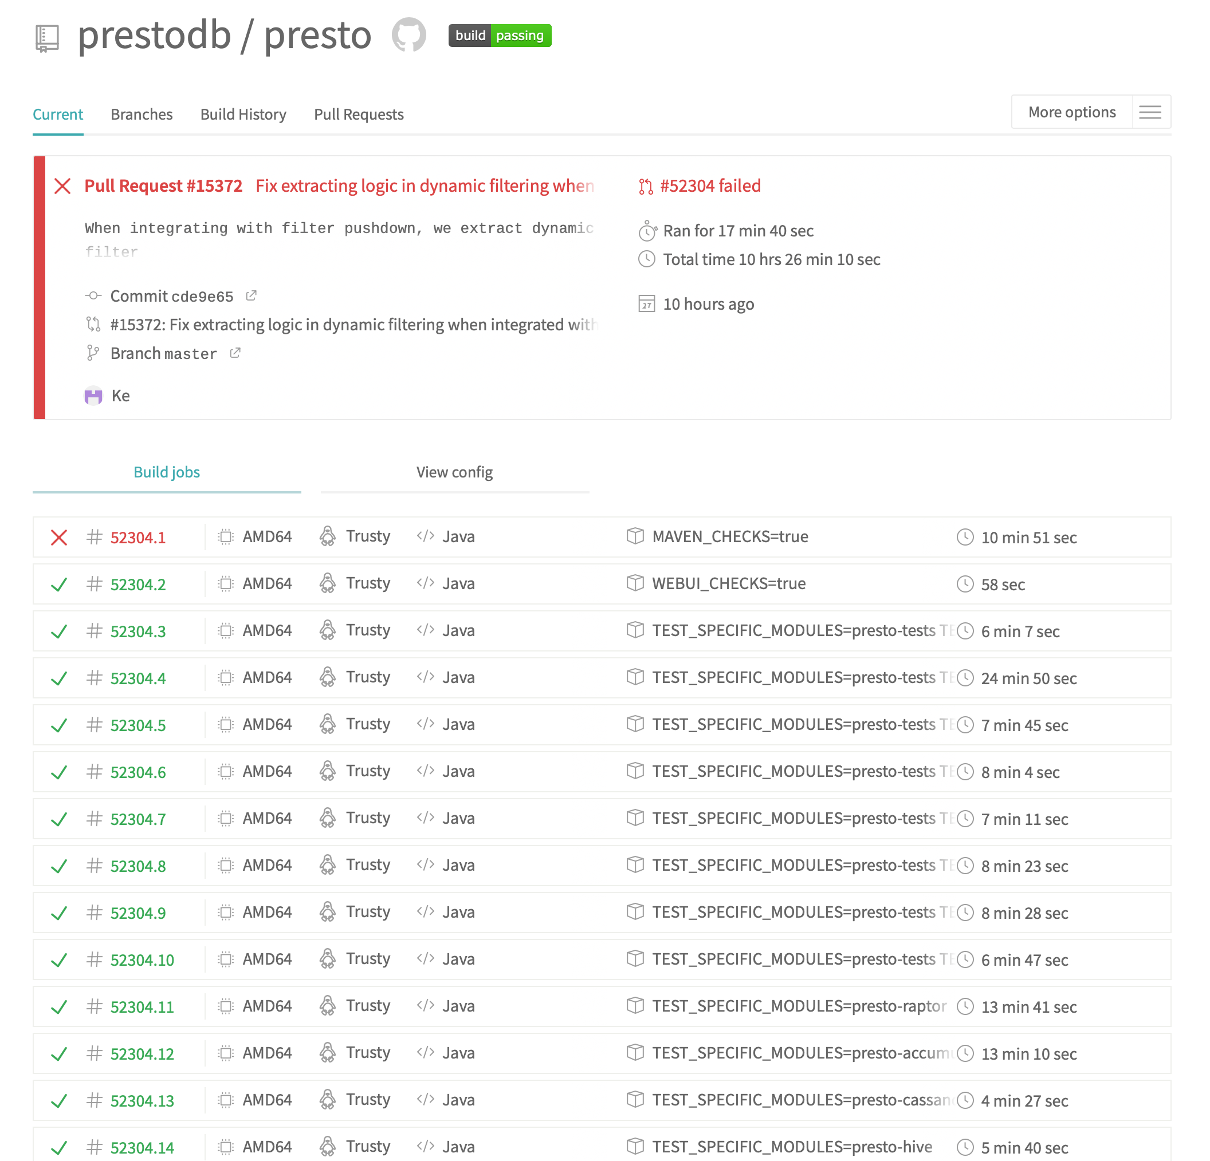
Example CI Pipeline
Open source project: PrestoDB
https://travis-ci.com/github/prestodb/presto
Notes:
Here’s a screenshot of a continuous integration pipeline from an open source project, Facebook’s presto database.
Point out: Run on pull request, runs multiple jobs

Slide 12
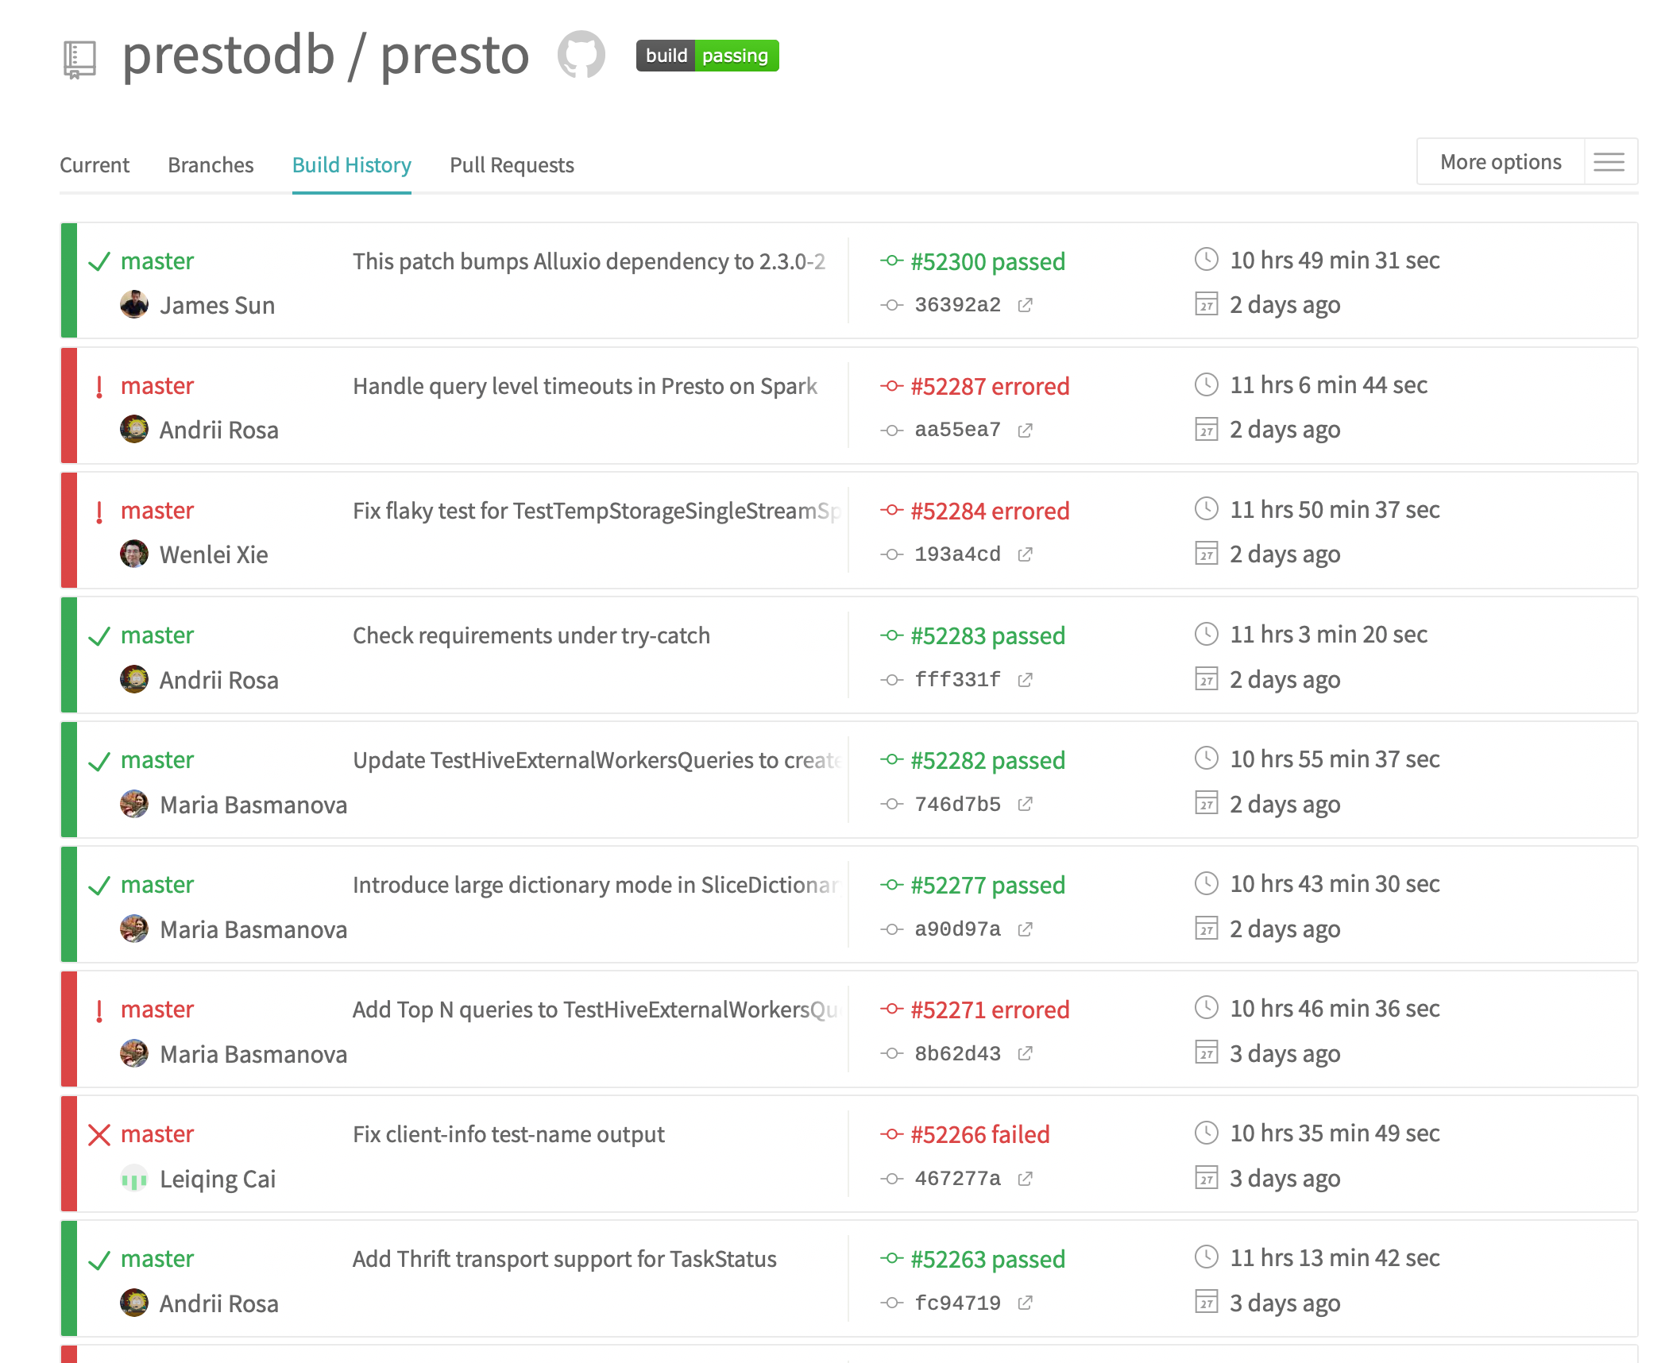
Example CI Pipeline - TravisCI
At a glance, see history of build
https://travis-ci.com/github/prestodb/presto
Notes:
Here’s another view of that same project’s CI pipeline: here we can see the history of each build. From this view, any developer can answer the simple question: “when did a test break? What fixed it?”

Slide 13
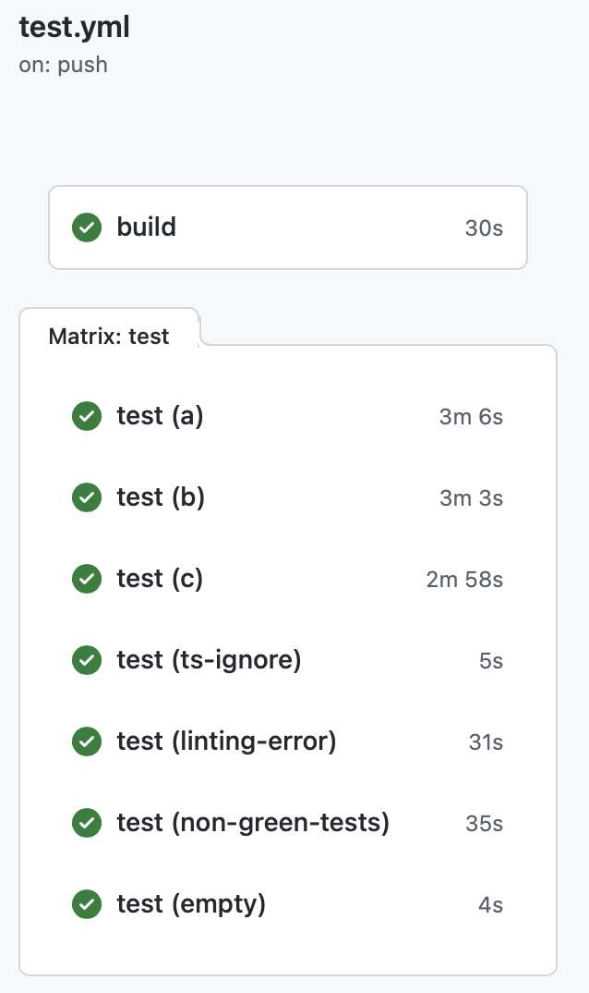
CI In Practice: HW3 Autograder
test.yml (CI workflow file)
GitHub Actions Results
name: 'Build and Test the Grader'
on: # rebuild any PRs and main branch changes
pull_request:
push:
branches:
- main
- 'releases/*'
jobs:
build:
runs-on: self-hosted
steps:
- uses: actions/checkout@v2
- uses: actions/setup-node@v2
with:
node-version: '16'
- run: |
npm install
test:
runs-on: self-hosted
strategy:
matrix:
submission: [a, b, c, ts-ignore, linting-error, non-green-tests, empty]
steps:
- uses: actions/checkout@v2
- uses: actions/setup-node@v2
with:
node-version: '16'
- uses: ./
with:
submission-directory: solutions/${{ matrix.submission }}
Notes:
By “Test”, we don’t just mean running Jest tests. A CI workflow consists of a set of “jobs”, which are simply scripts, in this case, written in a mix of Bash and TypeScript.
On the left, we can see the workflow that is run every time that we push a commit to the repository that hosts the HW3 autograder.
This workflow is triggered on any pull request on the repo, or on any push to the branch “main” or a branch that is prefixed with “releases/”.
There are two kinds of jobs: build, and test. Both run on our self-hosted github actions environment (runs-on), but there could be other values here to specify, say, an OS version to use.
The steps to build the project are to: 1. Check out the project, 2. setup nodeJS version 16, and 3. install it. If any of these steps fail, then the job fails, and we would see a red X in our build result.
Then, there is a job “test”, which in this case we allow to start running immediately (no dependency on build). The test job is parametrized over an array called “submissions”, which defines various example test suites that we test the autograder on with every commit (in GitHub Actions terminology, this is called a ‘build matrix strategy’). The test step also checks out the code, and also sets up NodeJS, and then it runs the autograder. The autograder is implemented in TypeScript as a GitHub Action itself, so we invoke it by telling GitHub to use the action defined in this repository (./), passing the spectiic submission directory that should be used to execute the autograder.
This workflow allows us to get very fast feedback on changes to the grading scripts – the grader is automatically executed in a clean environment on various representative submissions, and it can all happen in parallel.

Slide 14
CI Pipelines Automate Performance Testing
Example: Developing a Fuzzer
“Fuzzers” are automated testing systems that aim to automatically generate inputs to programs that cover code and reveal bugs
Fuzzers are non-deterministic: to evaluate with confidence, need repeated, long-running trials
Evaluating fuzzers is time consuming, determining which changes impact performance is confusing

Slide 15
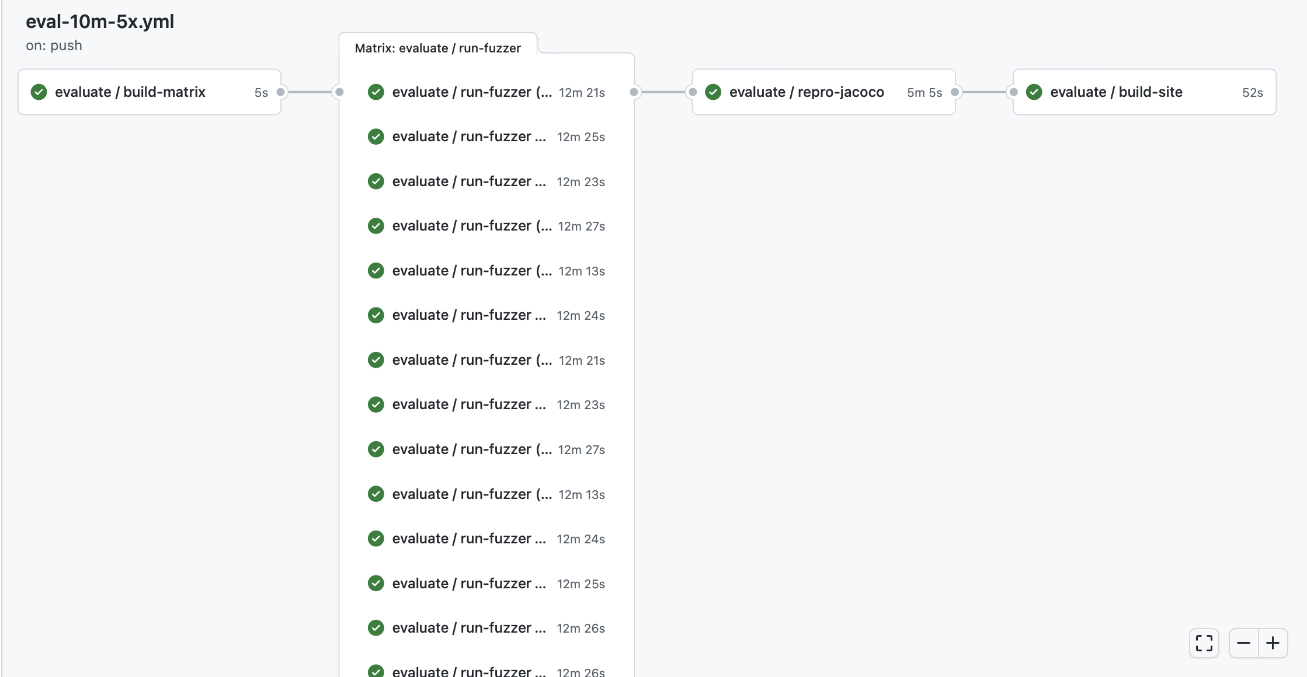
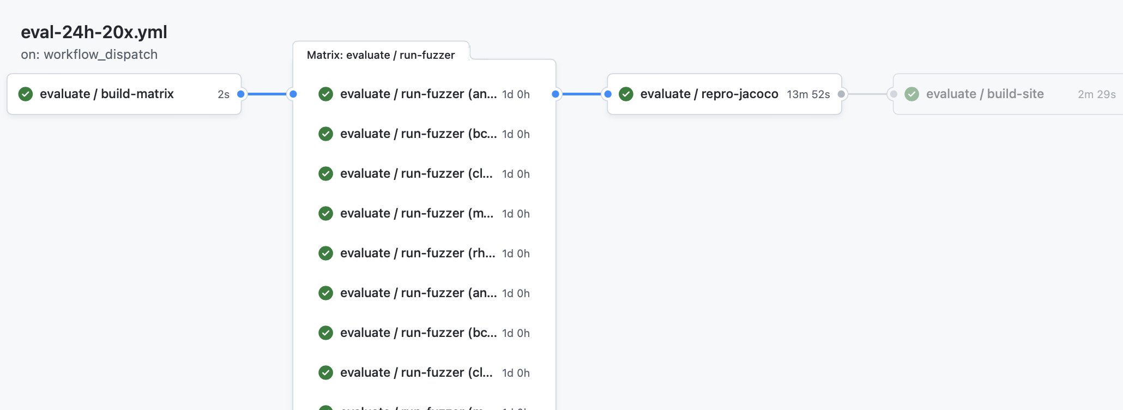
CI Pipelines Automate Performance Testing
Every commit: Run 10 minute performance test on 5 benchmarks, repeating each test 5 times (25 concurrent jobs)
On Demand: Run 24 hour performance test on 5 benchmarks, repeating each test 20 times (100 concurrent jobs)
https://github.com/neu-se/CONFETTI/actions
Notes:
These screenshots show the graphical summary of two CI pipelines set up for this fuzzer.
The top one shows a workflow that can run on every commit, providing useful feedback on performance and correctness in about 15 minutes: running a 10 minute performance test on 5 benchmarks, repeating each one 5 times (25 concurrent jobs needed)
The bottom one shows a workflow that runs only upon request, which performs a much more thorough evaluation: 20 repetitions of 5 benchmarks, with each running for 24 hours.
In both cases, there are 4 jobs defined: 1. build the matrix (run a script that will determine which benchmarks to run), 2. (in parallel) run the fuzzer on those benchmarks, 3. collect all of those results and reproduce them for later analysis, and 4. render a report into markdown and HTML that summarizes the results

Slide 16
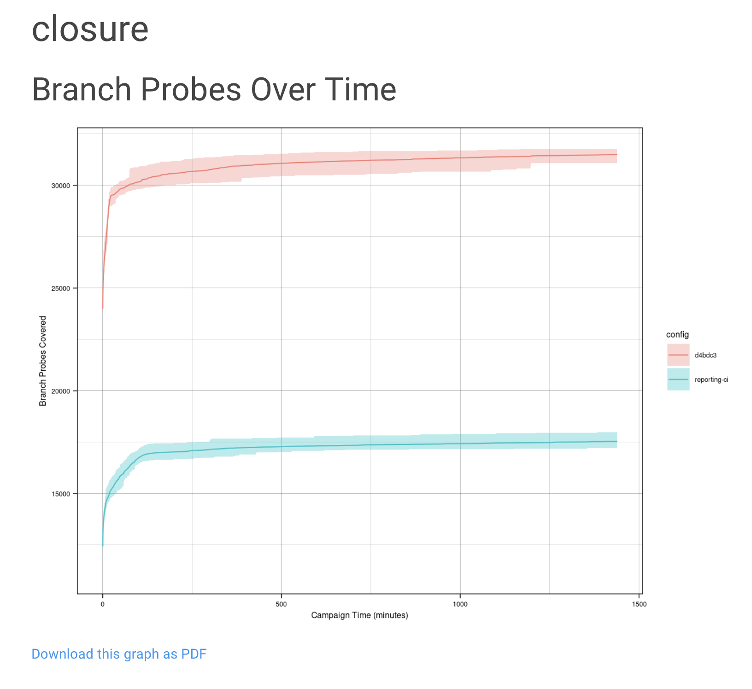
CI Pipelines Automate Performance Testing
On Demand: Run 24 hour performance test on 5 benchmarks, repeating each test 20 times (100 concurrent jobs)
https://github.com/neu-se/CONFETTI/actions
Notes:
Automating this kind of performance testing lets us get feedback much faster than if we had to do it manually. It also allows us to have a centralized repository of those results, so that we can track performance over time.
Here is an example of one of the graphs that get output from the report.
“branch probes over time” is one of the key performance indicators that fuzzers like this one are evaluated on. Since all of the data is centrally stored, it is easy to automate reports like this that compare the performance on the current commit to, say, another branch. This graph shows in red the current commit, and in blue, the main development branch.

Slide 17
Continuous Integration in Practice
Large scale example: Google TAP
>50,000 unique changes per-day, > 4 billion test cases per-day
Pre-submit optimization: run fast tests for each individual change (before code review). If fast tests pass, allow the merge to continue
Then: run all affected tests; “build cop” monitors and acts immediately to roll-back or fix
Build cop monitors integration test runs
Average wait time to submit a change: 11 minutes
“Software Engineering at Google: Lessons Learned from Programming Over Time,” Wright, Winters and Manshreck, 2020 (O’Reilly)

Slide 18
Continuous Integration
Summary and next steps
CI helps catch errors sooner in the software lifecycle by performing integration and end-to-end tests sooner
CI can be applied in small-scale projects by running complete test suites for each commit, or in larger projects by running pre-commit tests per-commit and complete integrations regularly
CI assumes the ability to automatically provision infrastructure on which to run those integration tests [next lesson]

